Slide 1
What Segments Does KLAS Cover in Healthcare Analytics?
Analytics
Healthcare Artificial Intelligence
Data Visualization and Reporting
Data Management*
Data and Analytics Platforms
Notes:
Data Management is a segment coming in the future.
Data and Analytics Platforms must contain elements of all three of the above segments.

Slide 2
How Does KLAS Define Data and Analytics Platforms?
Software products that provide enterprise analytics and reporting on clinical, operational, and financial data. Products ingest, analyze, and report or display data in a format such as dashboards or scorecards that is reasonably understandable to non-IT users.
In other words, a platform that includes all basic criteria and some advanced criteria from at least 4 of these 5 categories:
Data Ingestion
Data Management
Analytics
Advanced Analytics
Underlying Components

Slide 3
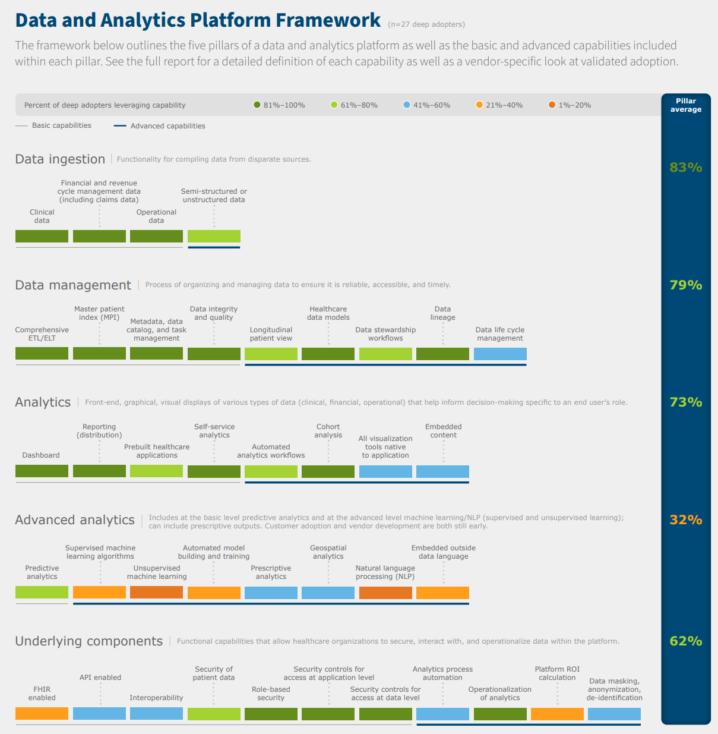

Slide 4
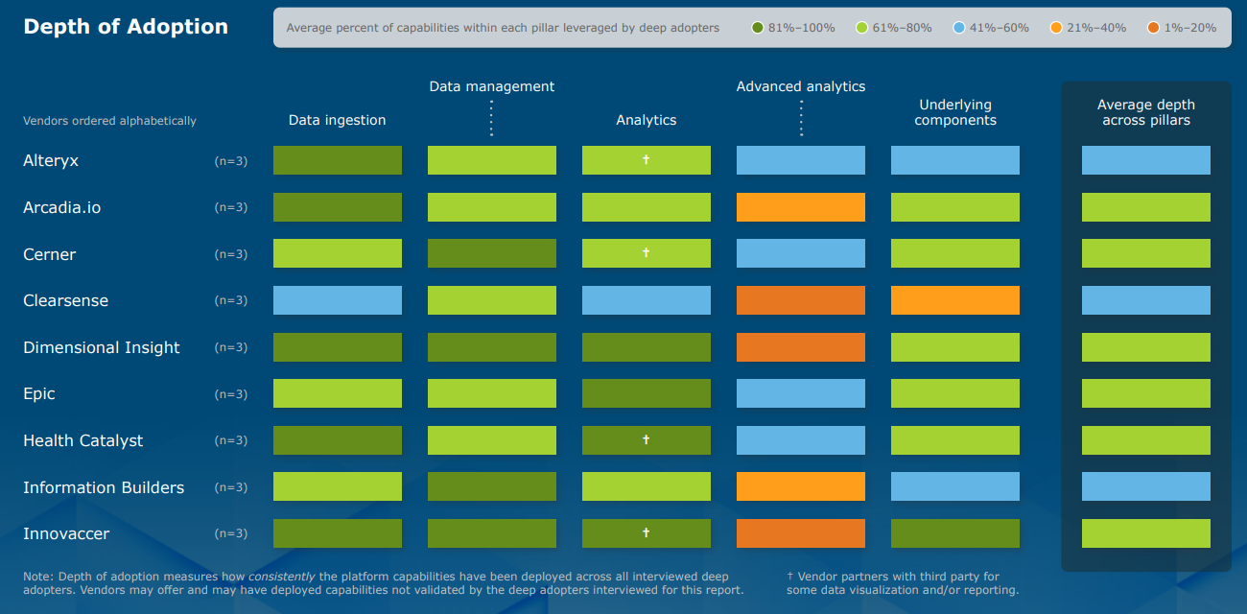

Slide 6
Artificial Intelligence
Data Science Solutions

Slide 7
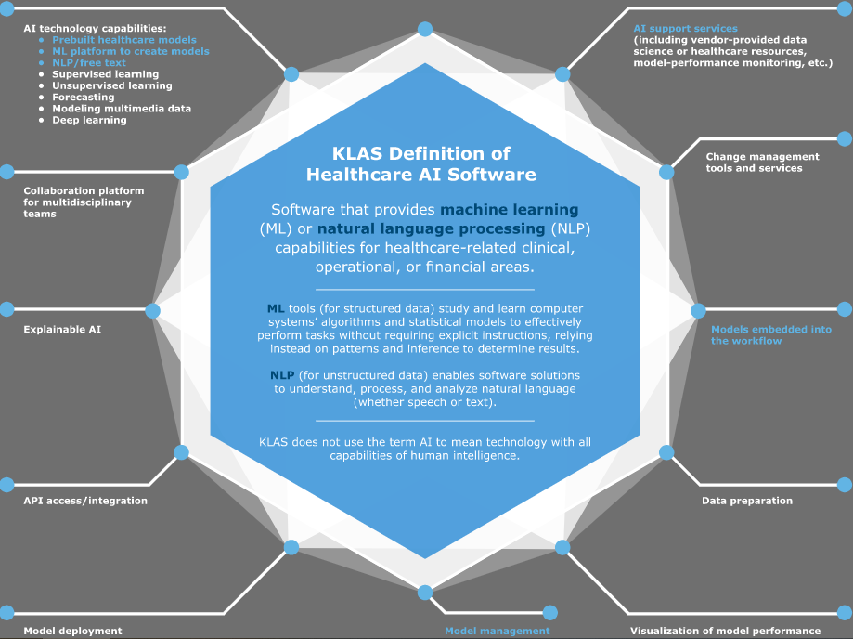
What is AI?
Roche Taxonomy: Clinical Trials and other AI Population Health Capabilities

Slide 8
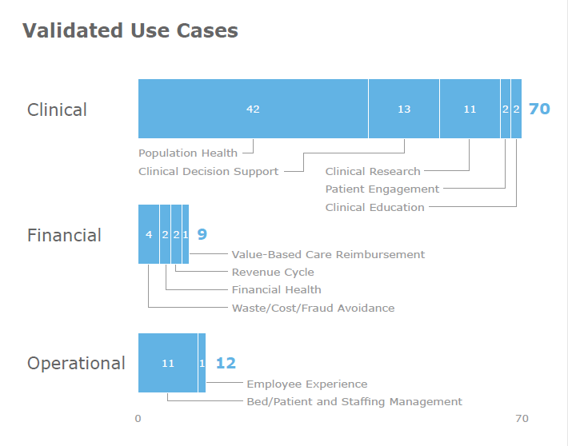
This chart shows Machine Learning use cases we validated from 57 unique organizations. Even though this data is from late 2019, it’s still relevant. Again, keep in mind this is for Data Science Solutions- (model creation/building/deployment)

Slide 9
Rated Healthcare AI Data Science Solutions

Slide 10
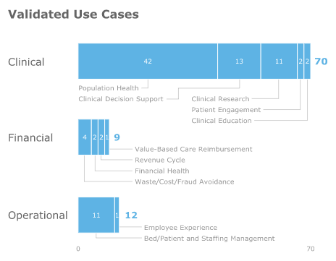
Market Energy is Starting to Increase Again Post Pandemic but Slowly
Energy during COVID decreased unless the solution was able to help with COVID
Providers are cost sensitive to what solutions they are planning to implement and AI can be seen as expensive and resource heavy
With research with the Centers of Connected Medicine starting to see an increase in energy around what AI may be able to do in the future, but adoption is still often done in pockets
AI is most used in value-based care use cases
Healthcare expertise from vendors drives decisions

